Slide 1
One-Web
Courses

Slide 2
Approach
The partnership maintains data in the ‘course database’ for FE and HE courses
‘Course database’ is a term covering the systems delivered by the MIS team in LIS
Tribal SITS
SPI
UHI records / www.studentjourney.uhi.ac.uk
Web database
FE is maintained at respective partners
HE is maintained via marketing@uhi.ac.uk
This is ‘sync’d’ to T4 nightly

Slide 3
Quirks
Renaming
Title change Engineering
Level change SCQF 4
Qualification change SVQ
Removal

Slide 4
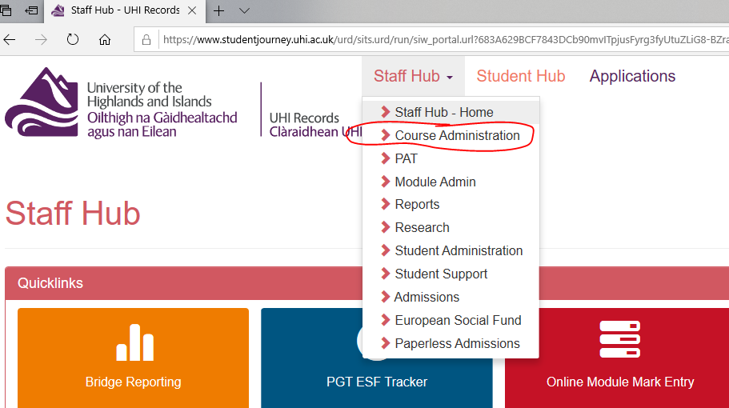
Course database to T4

Slide 5
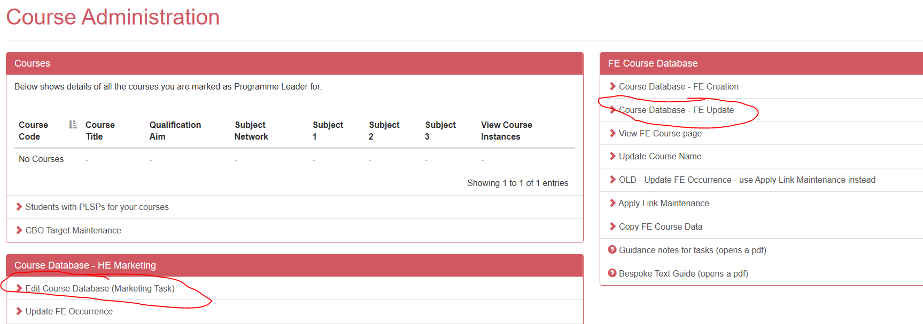
Course database to T4

Slide 6
Course database to T4 – HE & FE
Title
FE – FE Creation Link
HE – HE Creation Link - SRO
Qualification
FE – FE Update Link
HE – SRO

Slide 7
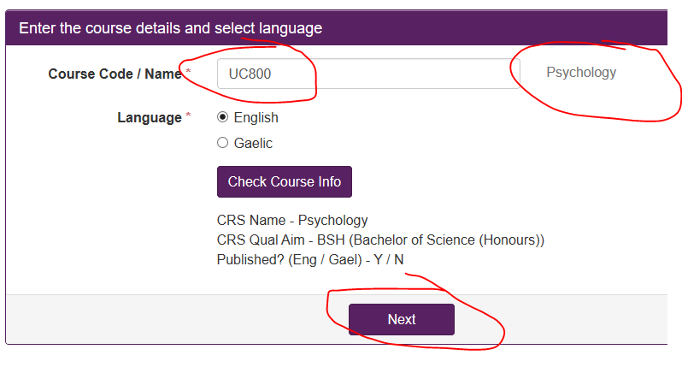
Course database to T4 - HE & FE

Slide 8
Course database to T4 - HE

Slide 9
Course database to T4 - HE

Slide 10
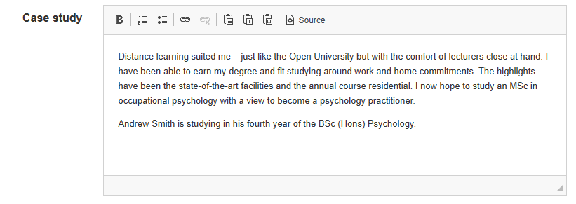
Course database to T4 - HE

Slide 11
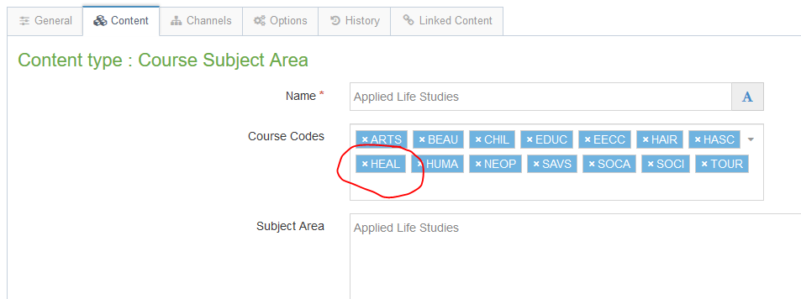
Course database to T4 - HE

Slide 12
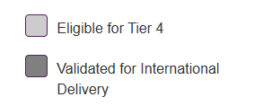
Course database to T4 - HE

Slide 13
Course database to T4 - HE
Used in the A-Z search on our sites
Avoid use of level
Avoid use of ‘degree’ or description of course type

Slide 14
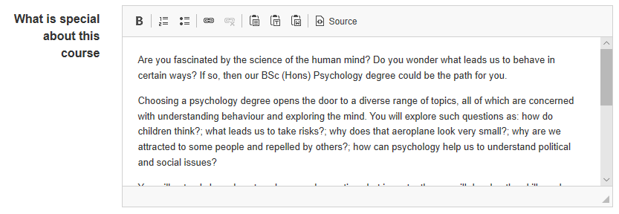
Course database to T4 - HE

Slide 15
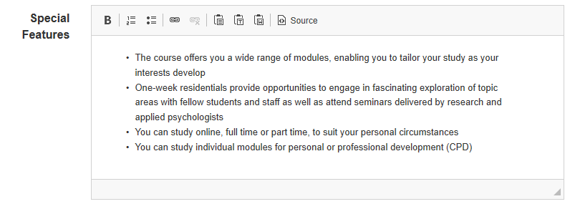
Course database to T4 - HE

Slide 16
Course database to T4 - HE

Slide 17
Course database to T4 - HE
Used to insert YouTube Video
ONLY the video code

Slide 18
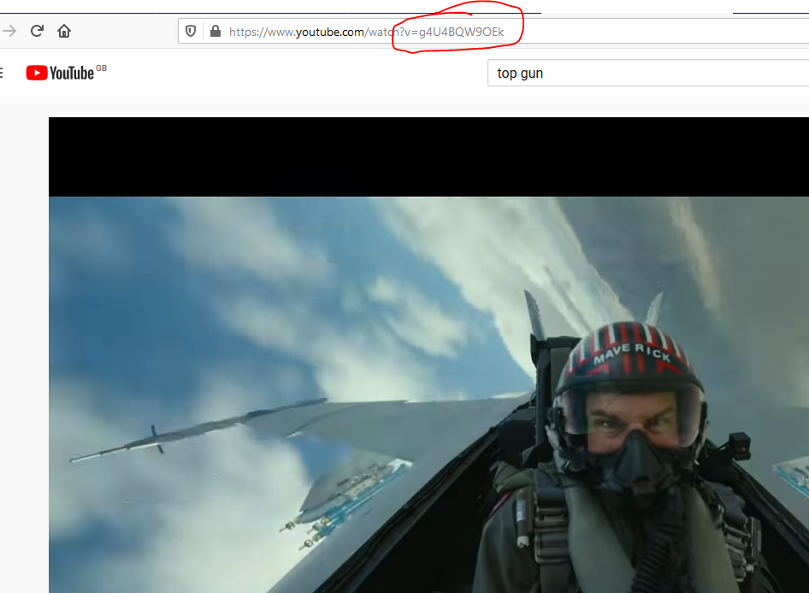
Extras - Video
The video must be on YouTube
Only the unique video code is required. Nothing else

Slide 19
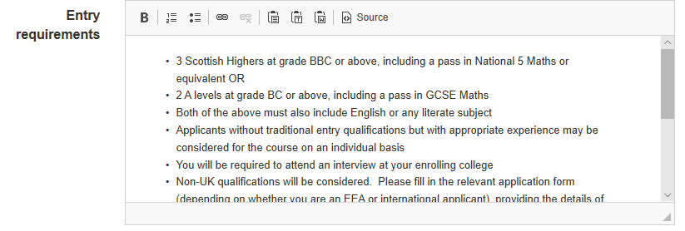
Course database to T4 - HE

Slide 20
Course database to T4 - HE
Not a database field. Applied to HE as either generic statement as above. Or
Specific e.g. Golf @ Dornoch where we have CityHeart

Slide 21
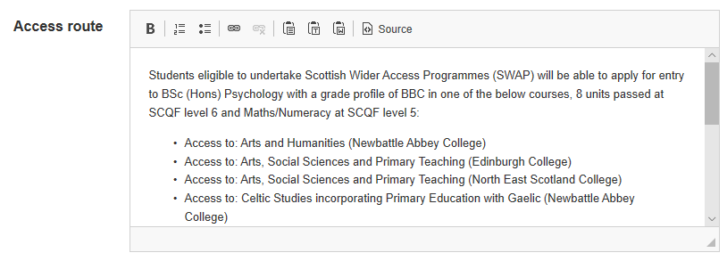
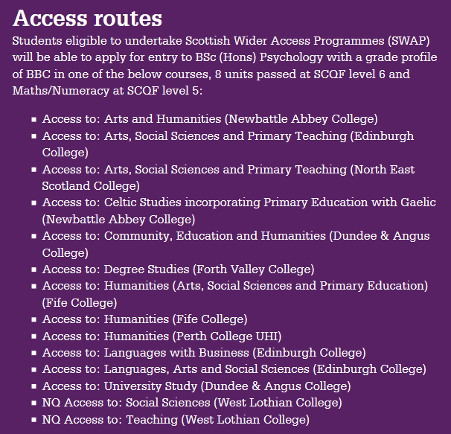
Course database to T4 - HE

Slide 22
Course database to T4 - HE
Used for ‘notes to self’. Only visible within the course database

Slide 23
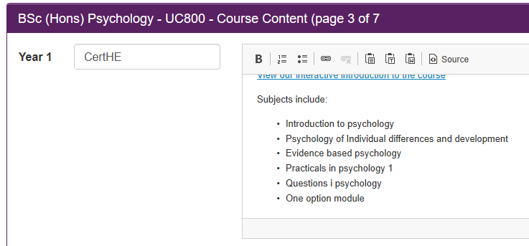
Course database to T4 - HE

Slide 24
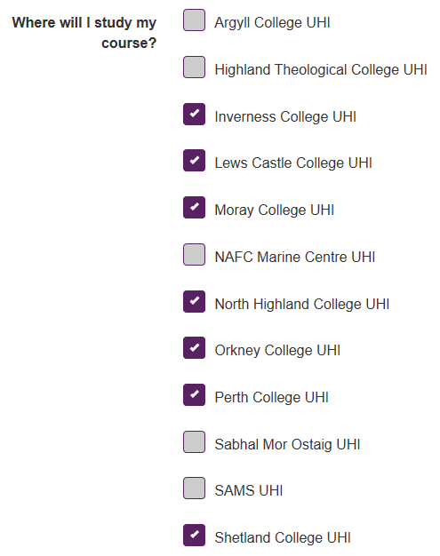
Course database to T4 - HE

Slide 25
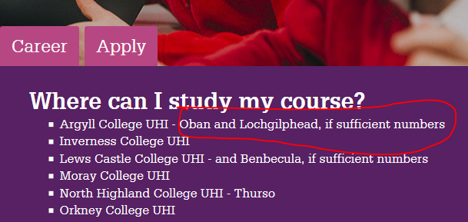
Course database to T4 - HE

Slide 26
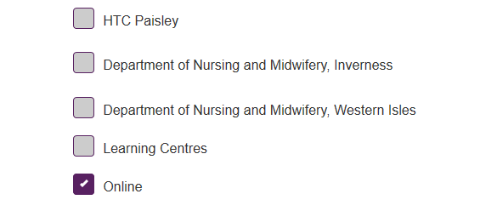
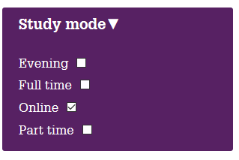
Course database to T4 - HE

Slide 27
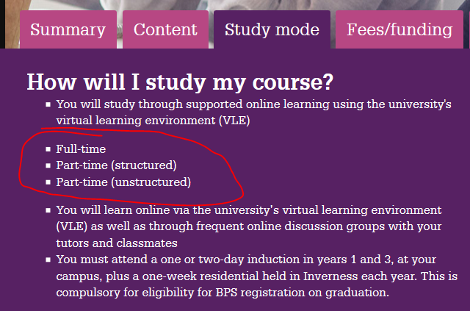
Course database to T4 - HE

Slide 28
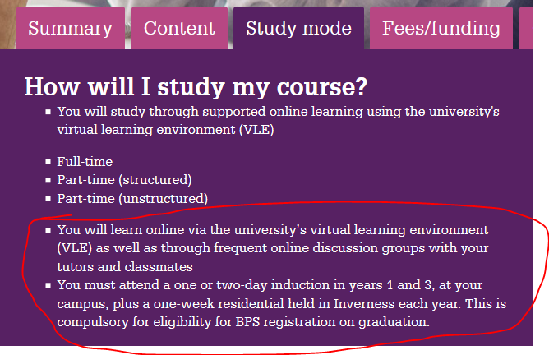
Course database to T4 - HE

Slide 29
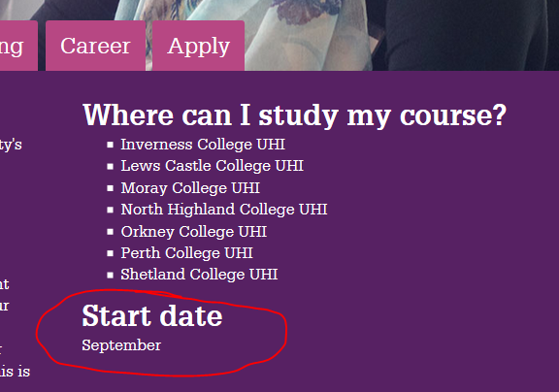
Course database to T4 - HE

Slide 30
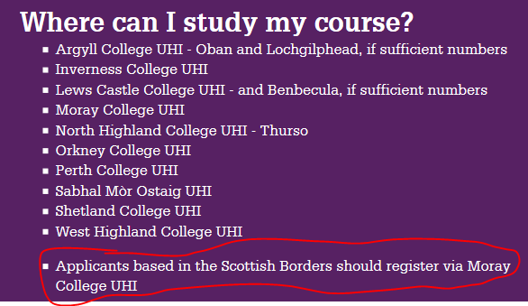
Course database to T4 - HE

Slide 31
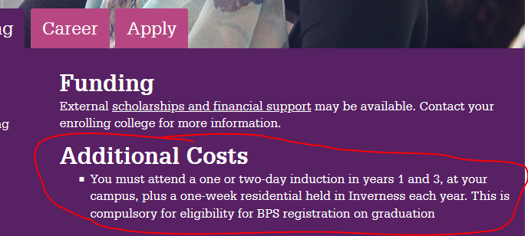
Course database to T4 - HE

Slide 32
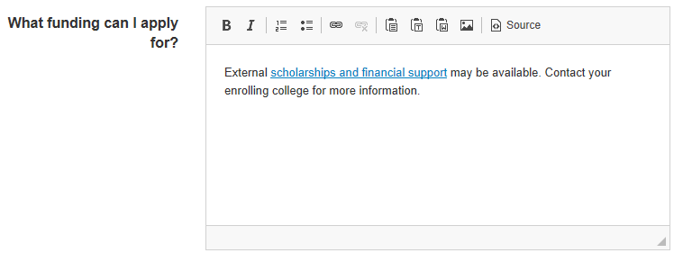
Course database to T4 - HE

Slide 33
Course database to T4 - HE

Slide 34
Course database to T4 - HE

Slide 35
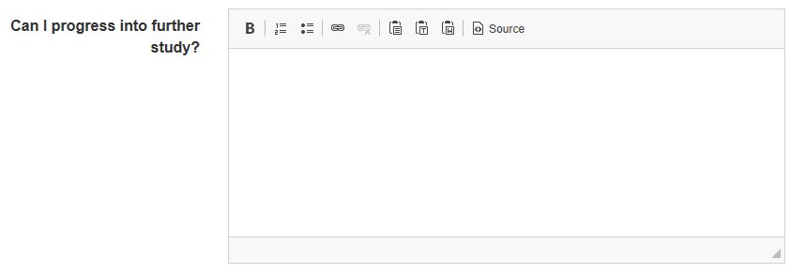
Course database to T4 - HE

Slide 36
Course database to T4 - HE
Uncheck to remove from website

Slide 37
Course Database to T4 - FE

Slide 38
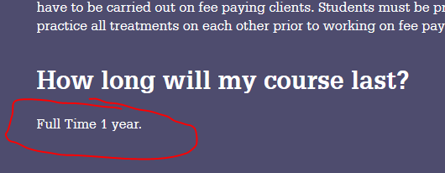
Course Database to T4 - FE

Slide 39
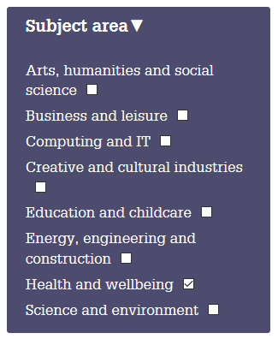
Course Database to T4 - FE

Slide 40
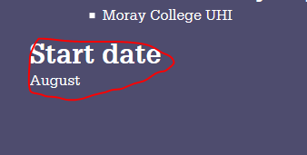
Course Database to T4 - FE

Slide 41
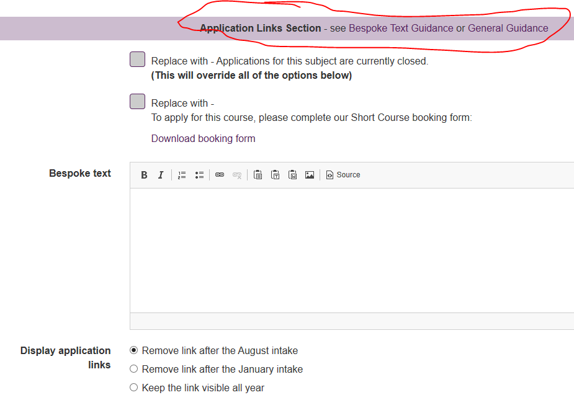
Course Database to T4 - FE

Slide 42
Course Database to T4 - FE

Slide 43
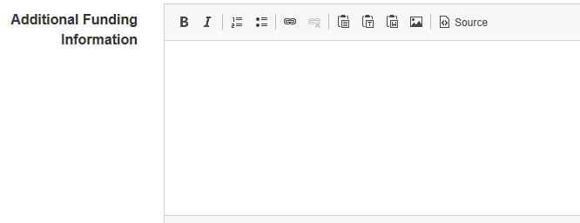
Course Database to T4 - FE

Slide 44
Course Database to T4 - FE
To add YouTube video to a course.
Only need the code

Slide 45
Course Database to T4 - FE
Use this for SCQF level
NOT title
NOT level

Slide 46
Course Database to T4 - FE
Not used on web

Slide 47
Course Database to T4 - FE
Used in background on web for search

Slide 48
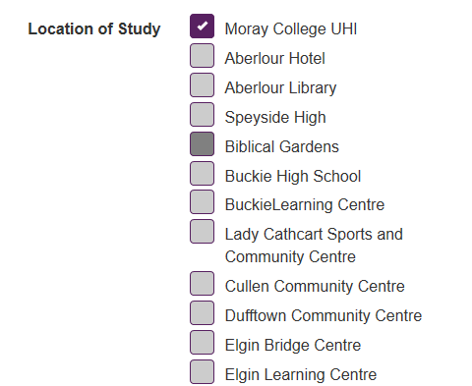
Course Database to T4 - FE
Partner specific

Slide 49
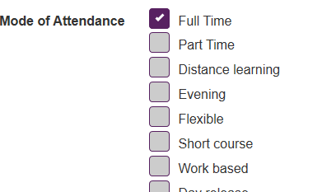
Course Database to T4 - FE

Slide 50
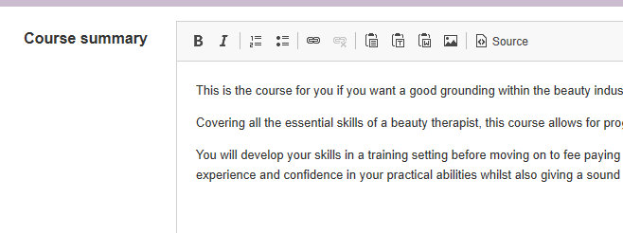
Course Database to T4 - FE

Slide 51
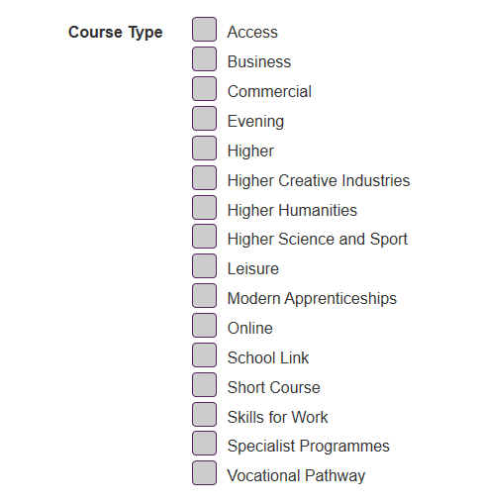
Course Database to T4 - FE
x

Slide 52
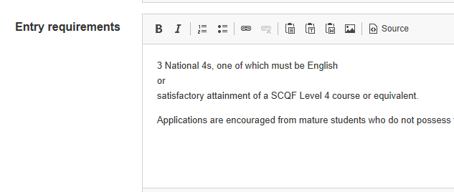
Course Database to T4 - FE

Slide 53
Course Database to T4 - FE

Slide 54
Course Database to T4 - FE

Slide 55
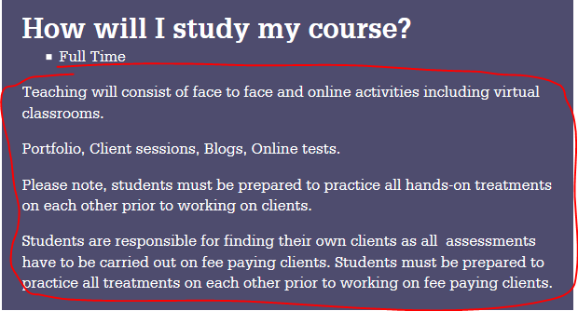
Course Database to T4 - FE

Slide 56
Course Database to T4 - FE
Not used on web

Slide 57
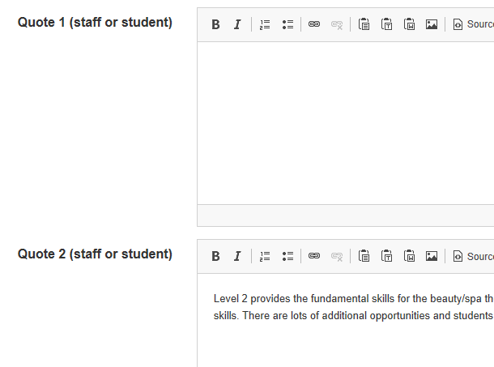
Course Database to T4 - FE
Use quotes in order.

Slide 58
Course Database to T4 - FE

Slide 59
Extras - FAQ
The course database cannot accept ‘extra’ files
An FAQ can be prepared as a PDF and uploaded to T4 by webteam
Ensure PDF is correctly title https://www.t4help.uhi.ac.uk/naming-things/naming-files-in-general/doc-and-pdf-titles/
Webteam can provide a link which can be inserted in the course database

Slide 60
Extras - Banners
Every One-Web site has a default course banner image
Any course can have its own banner.
The same HE course can have different banners on different sites
Banners can be ‘mirrored’
You can control banners as per https://www.t4help.uhi.ac.uk/content-types/course/course-banner-image/

Slide 61
Extras - Quotes
Every course can have up to 3 profiles. Students, staff, employers, alumni.
The quote is entered on the course database
Each quote requires an image to be entered on T4. You can do this as per https://www.t4help.uhi.ac.uk/content-types/course/course-quote-images/

Slide 62
Extras - Fees
Fees are handled by T4 as they are complex and lengthy and can require formatting.
Every One-Web site has default Fees text. If no other action is taken then this will display.
Specific courses can have their own fees. Multiple courses can have the same fees.
Levels of course can have their own fees e.g. BSc. Multiple course levels can have the same fees.

Slide 63
Extras - Accreditation
Where a course is officially accredited and we are allowed to use a 3rd party logo to show this, this can be added.
As with FAQ, the course database cannot accept an image file.
The file is provided to webteam who will upload to T4 and provide HTML
That HTML can be inserted in the course database

Slide 64
Extras - Image
An image may be added if it adds value to the text content.
The same procedure as Accreditation logos is followed.

Slide 65
Extras - KIS
This will be automatically added to any full-time HE UG course

Slide 66
Design
Delivered in 2014
Tested at point of delivery
Tested in 2019 by Kenny
Piloting ‘message us’ as part of course - apply – journey.
Went live w/c 24/02/2020

